Slide 1
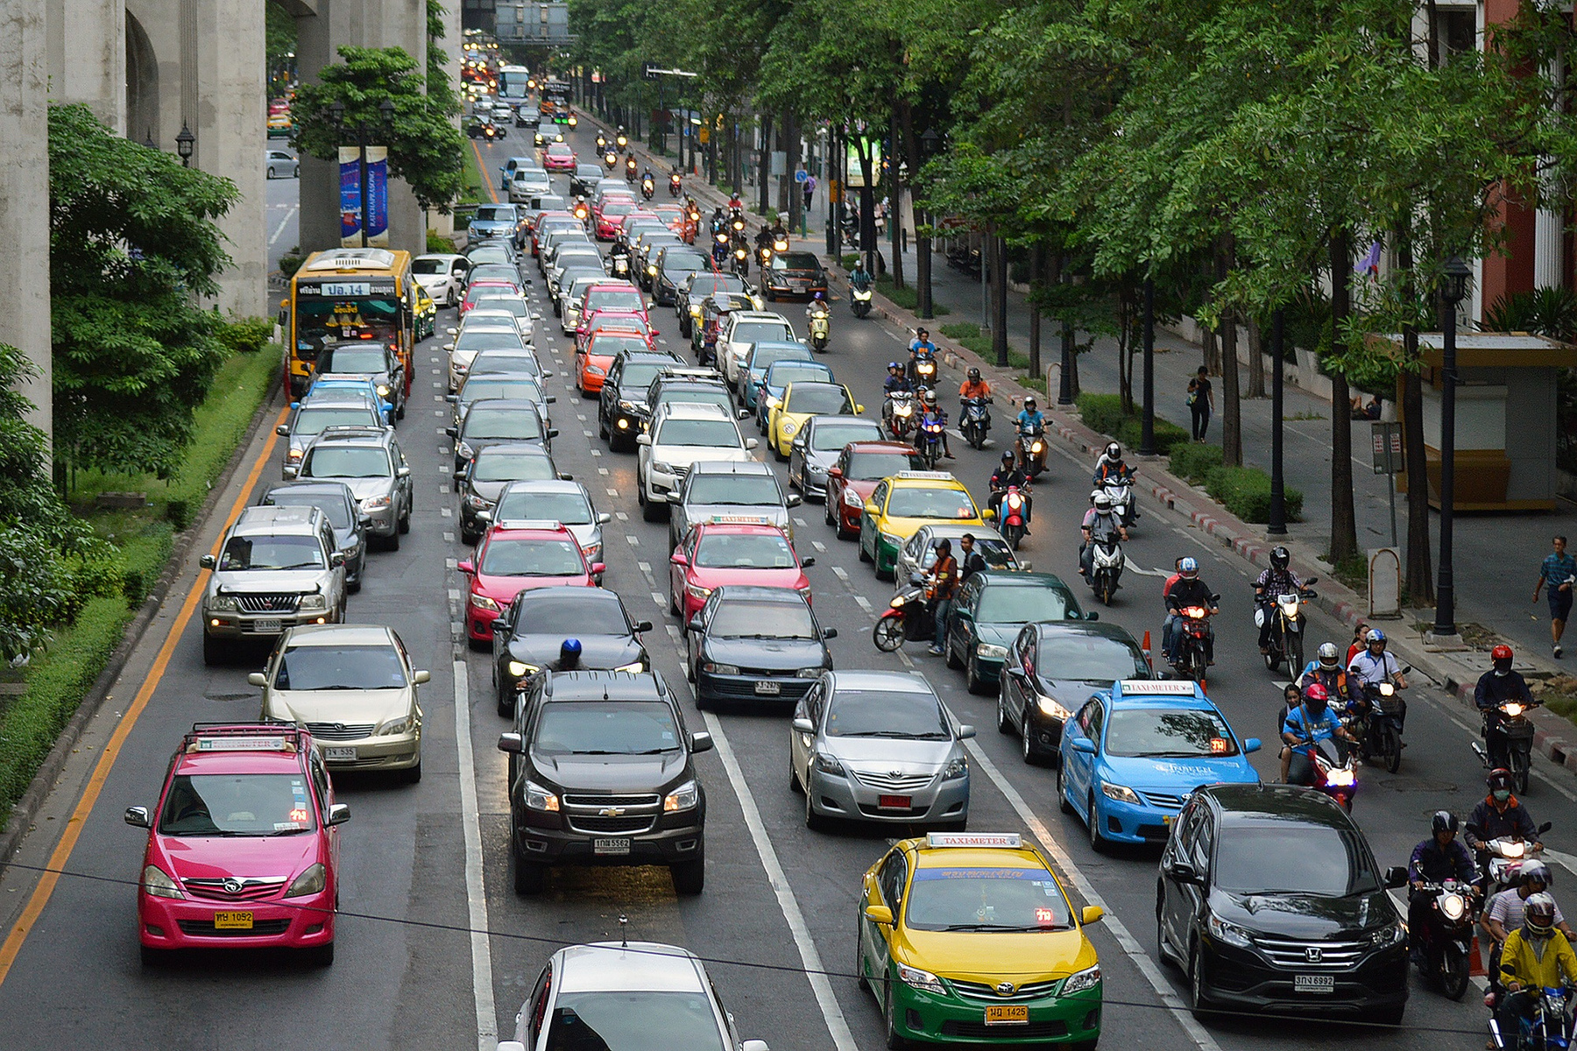



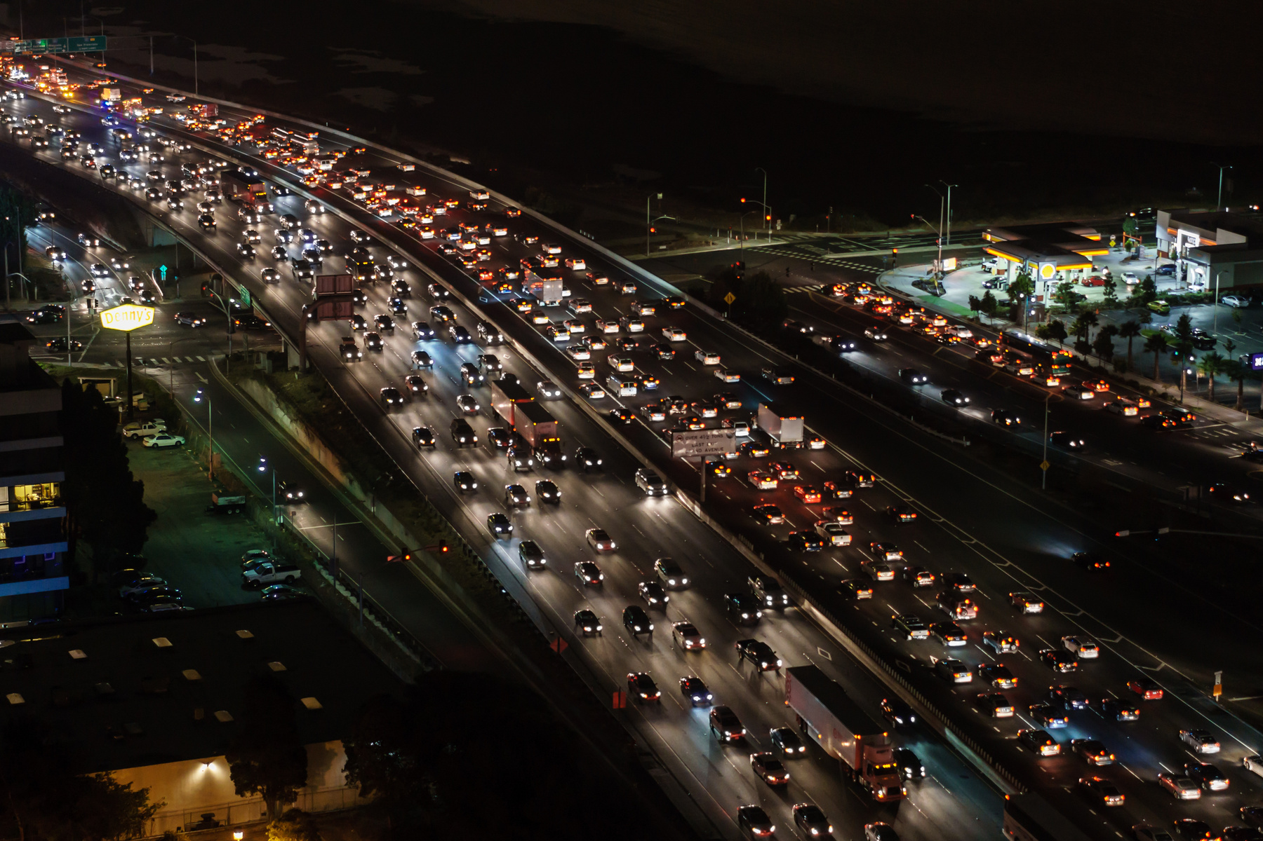
NEURO
FLEETX
Presented by: M.jayanth

Slide 2



PROBLEM STATEMENT
Urban mobility faces major challenges such as traffic congestion, inefficient route planning, and lack of real-time insights for fleet managers.
Traditional fleet systems fail to adapt dynamically to changing traffic conditions.
Manual operations result in poor customer satisfaction and increased fuel and time consumption.

Slide 3

NeuroFleetX provides a smart, AI-driven urban mobility platform.
Uses Artificial Intelligence, IoT, and Predictive Analytics to deliver:
Real-time vehicle and driver tracking
Predictive maintenance and performance analysis
Route optimization using ML-based traffic prediction
Integrated customer service and fleet management dashboard
Built for scalability and mobile-first enterprise use.
SOLUTION

Slide 4
Developed modules:
Fleet Management Dashboard
Customer Booking & Notification System
Predictive Maintenance Model
Real-Time Tracking Interface
Tech Stack: React, Springboot, ML API Integration
Features:
Live vehicle tracking
Automated alerts and performance analytics
Data-driven decision support for fleet managers
IMPLEMENTATION

Slide 5
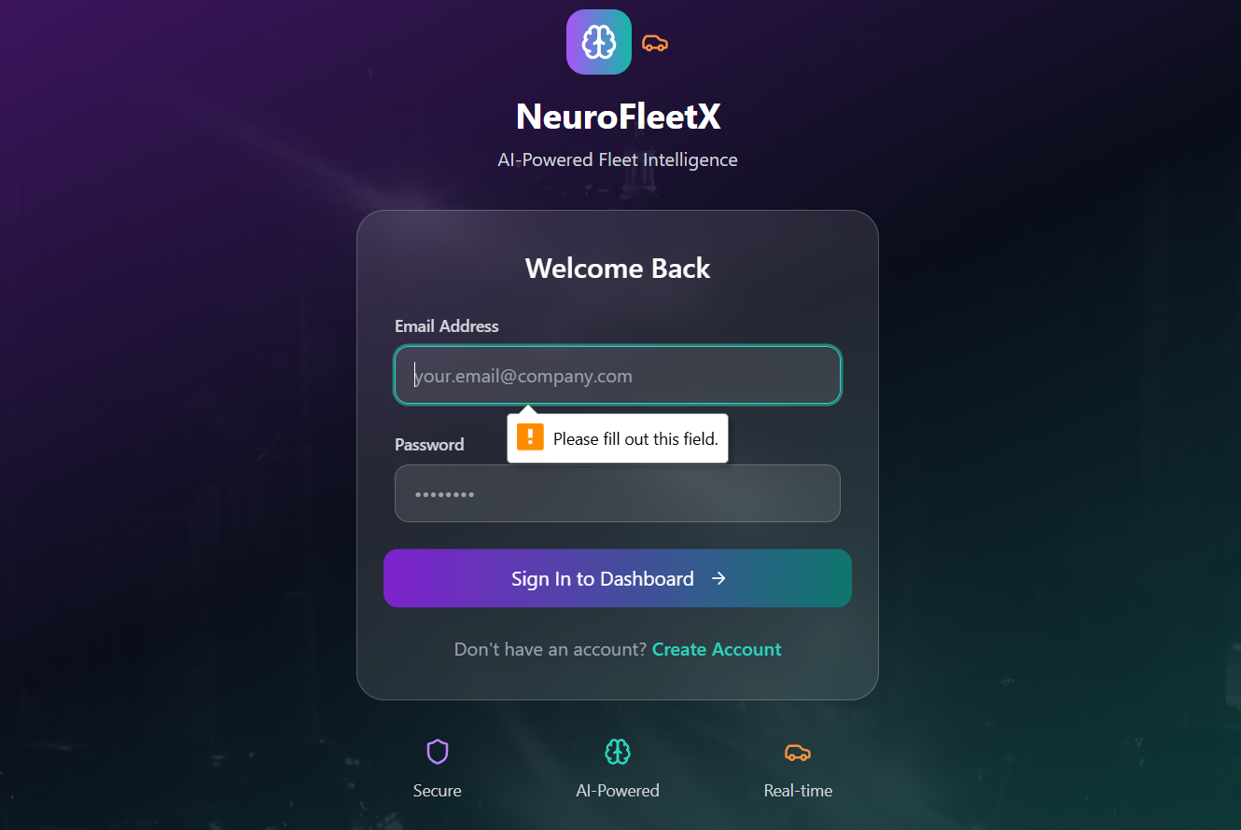


CONCEPT 1
Login page
testing the login page by not giving the email address and password that works good.

Slide 6
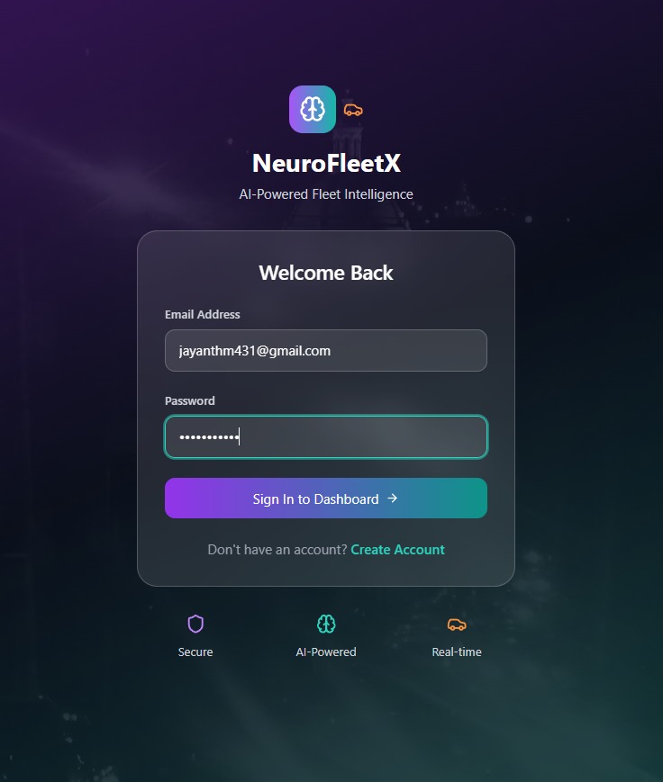
CONCEPT 1.1
Login page
Testing the login page by entering the email address and password that work well. and shows the dashboard.

Slide 7
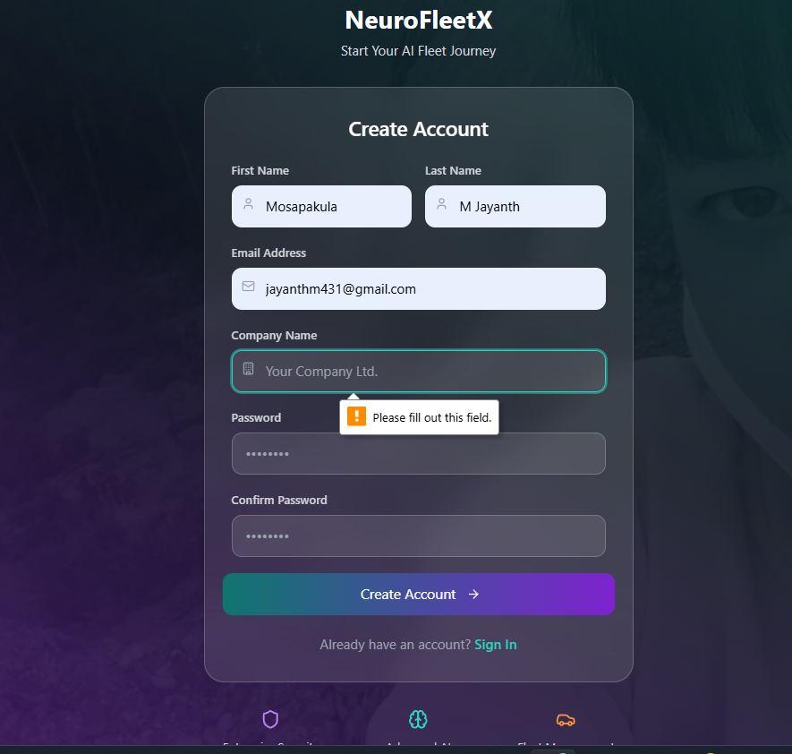
CONCEPT 2
Sign in page
Testing the sign-in by giving some details that work well. and shows a pop-up message, please fill out this field.

Slide 8
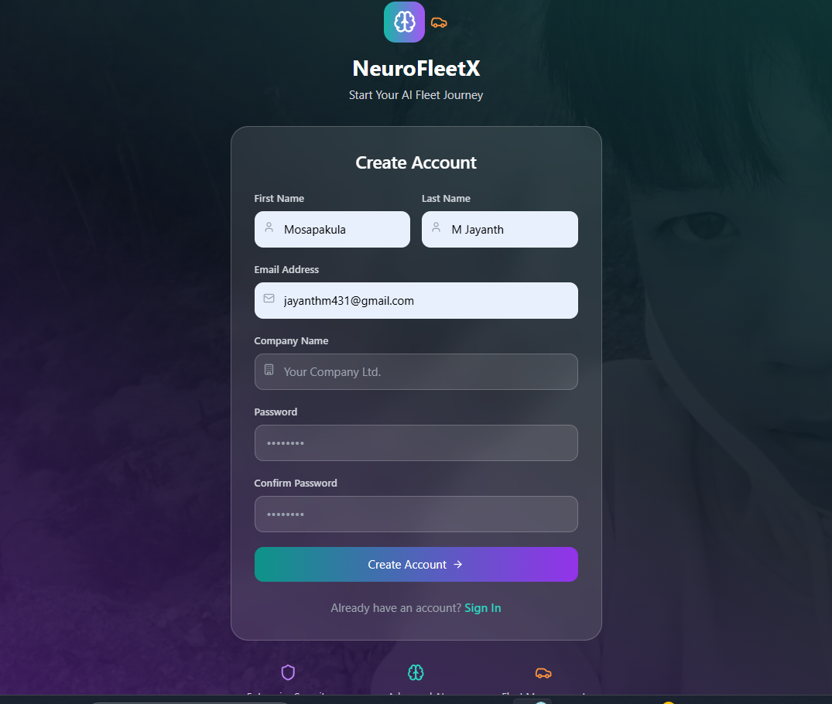
CONCEPT 2.1
Sign in page
After filling in all the details, it will redirect to the login page. after we log in with our email and password, it will redirect us to the dashboard.

Slide 9
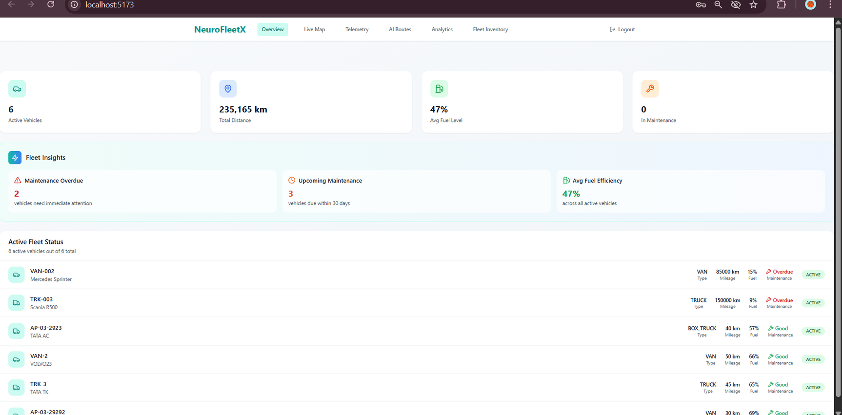
CONCEPT 1.1
Dashboard overview
This is the dashboard that displays the various features of the project NeuroFleetX that are build in the feature.

Slide 10
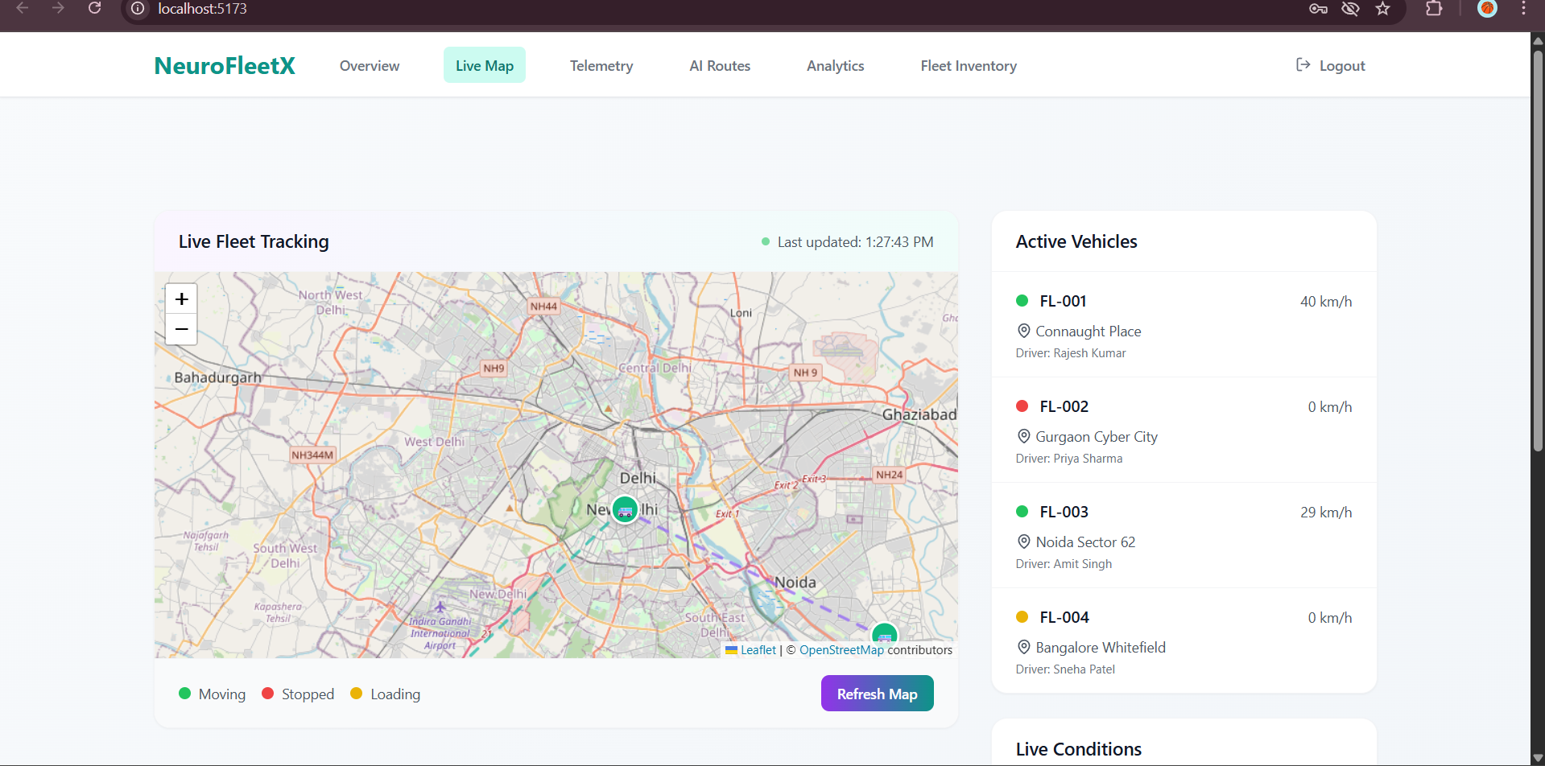
Live map page

Slide 11
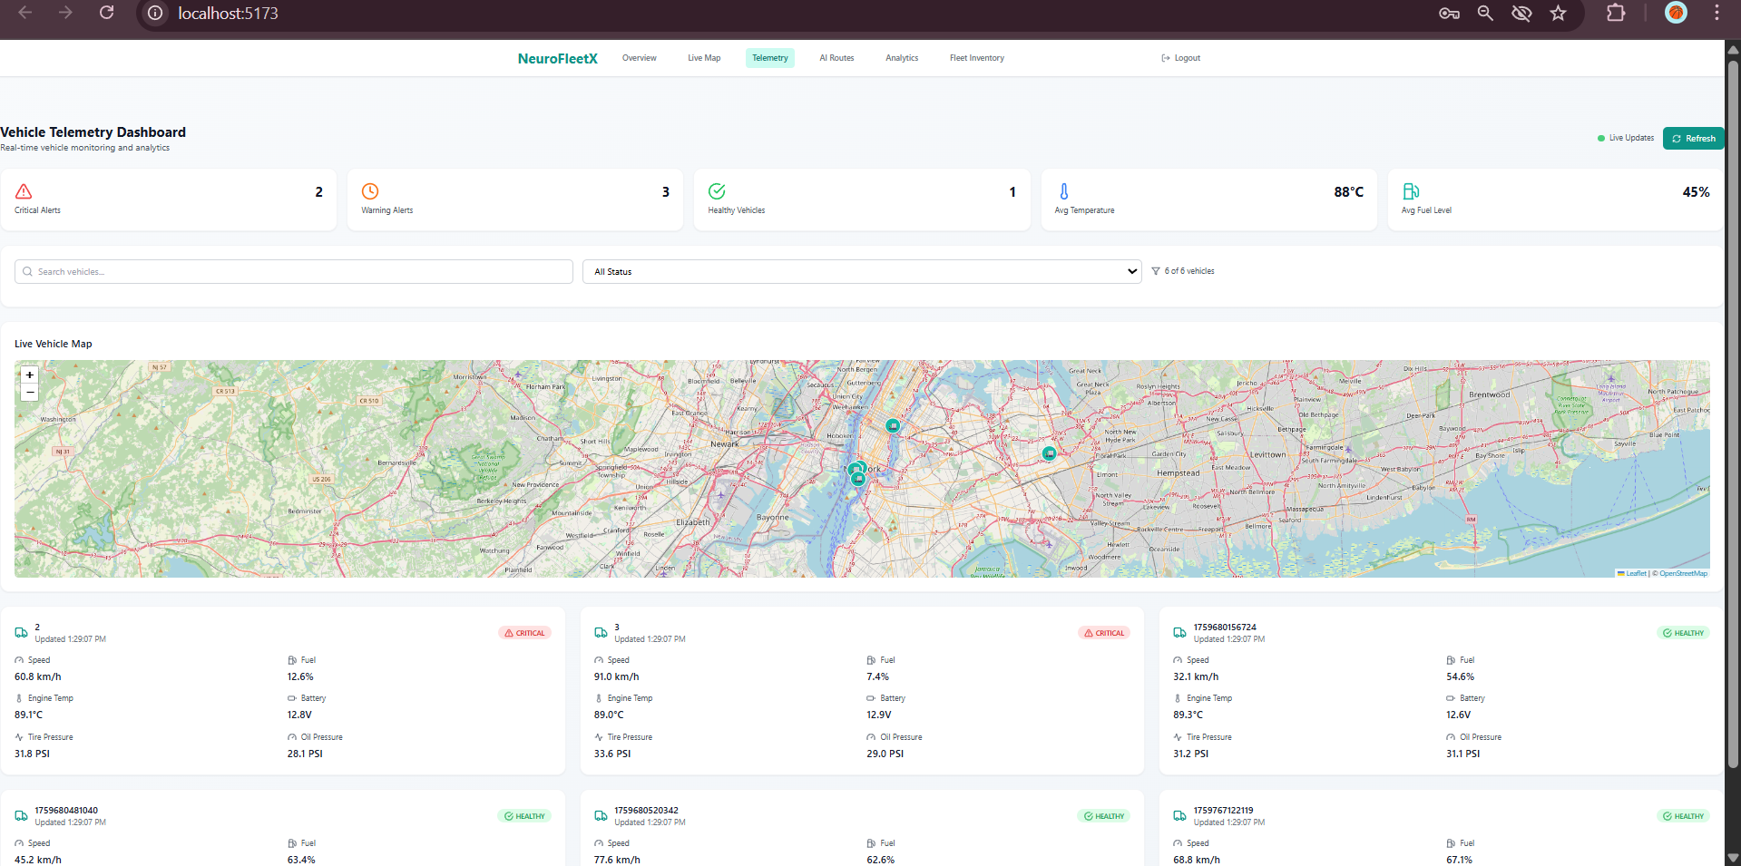
Fleet telemetry page

Slide 12
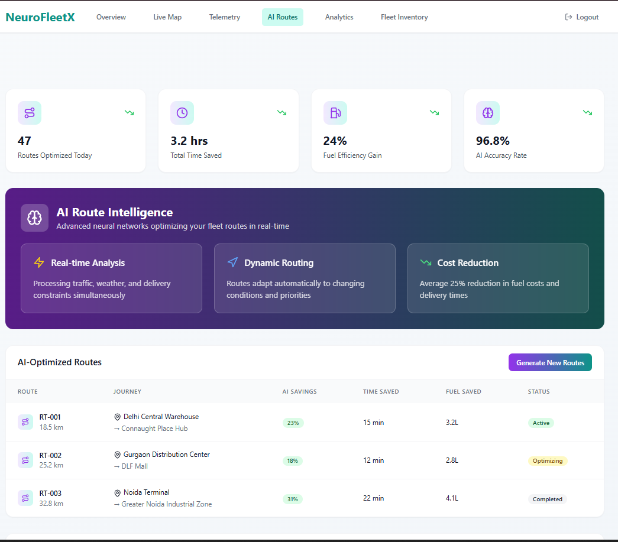
Fleet telemetry page

Slide 13
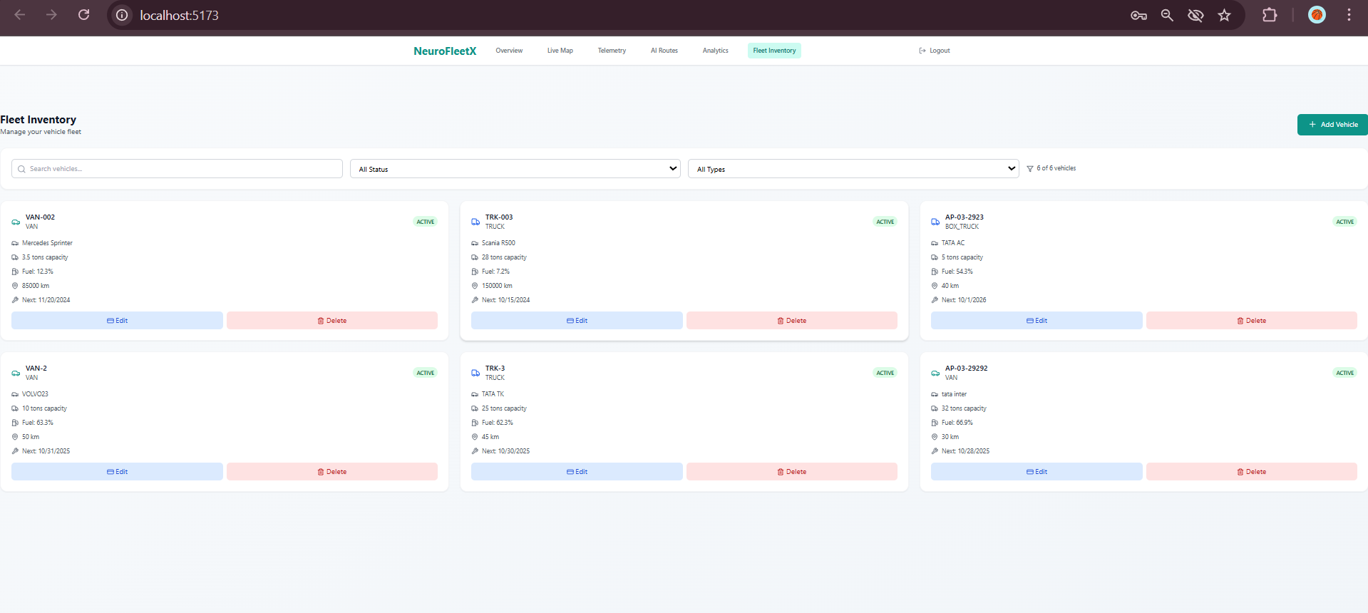
Fleet Inventory page

Slide 14
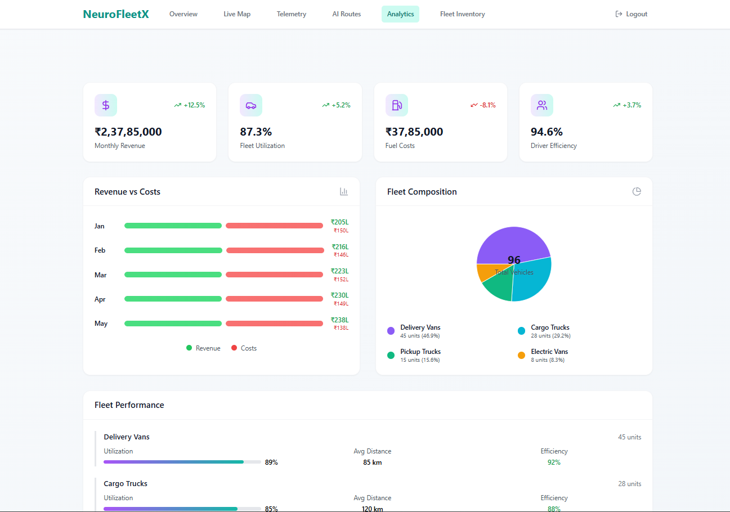
Fleet Analytics page

Slide 15
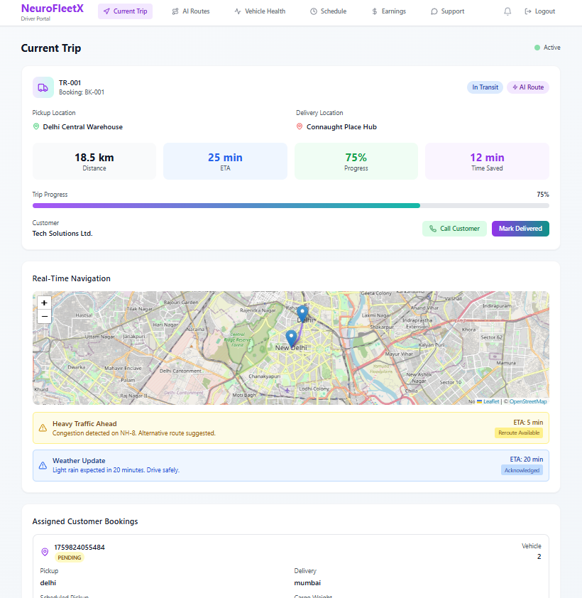
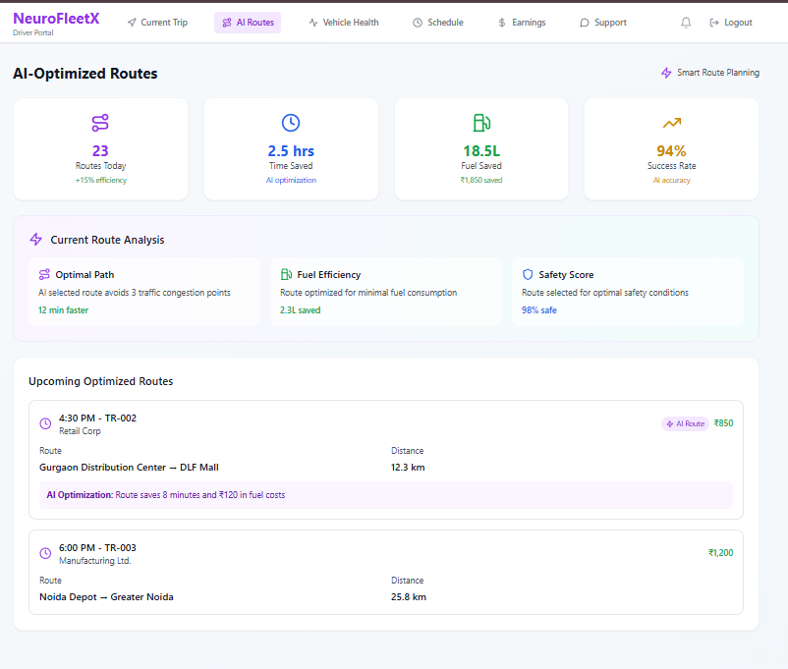
Driver portal pages

Slide 16
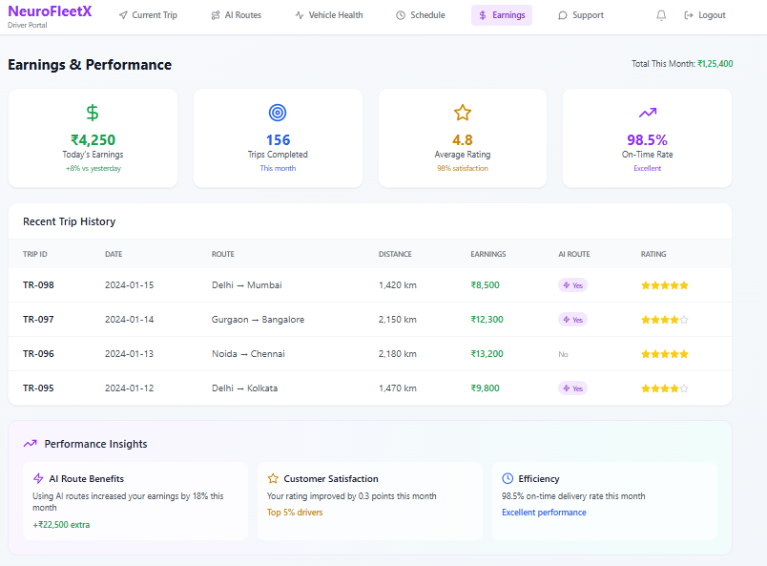
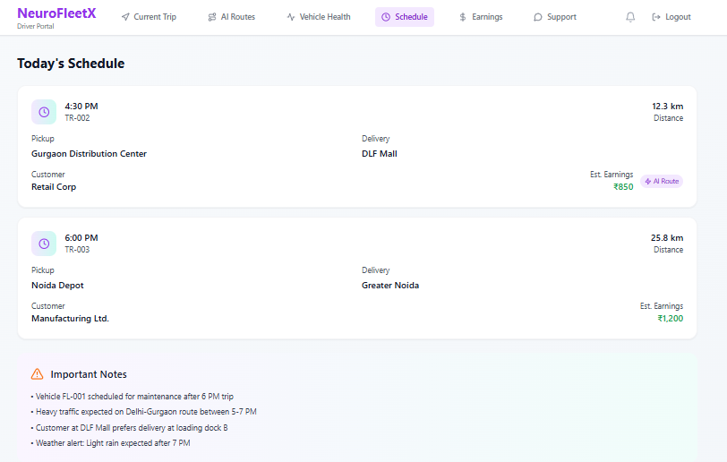
Driver portal pages

Slide 17
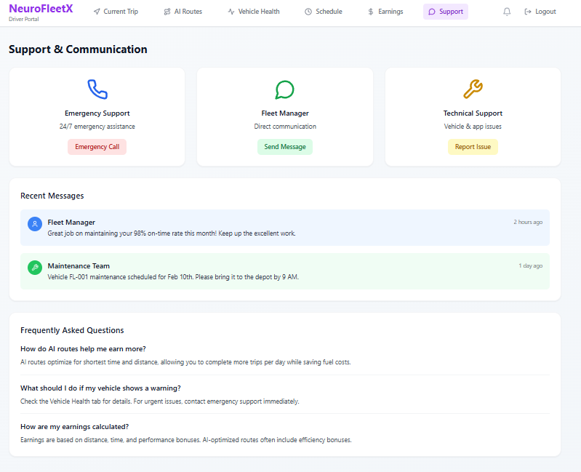
Driver portal pages

Slide 18
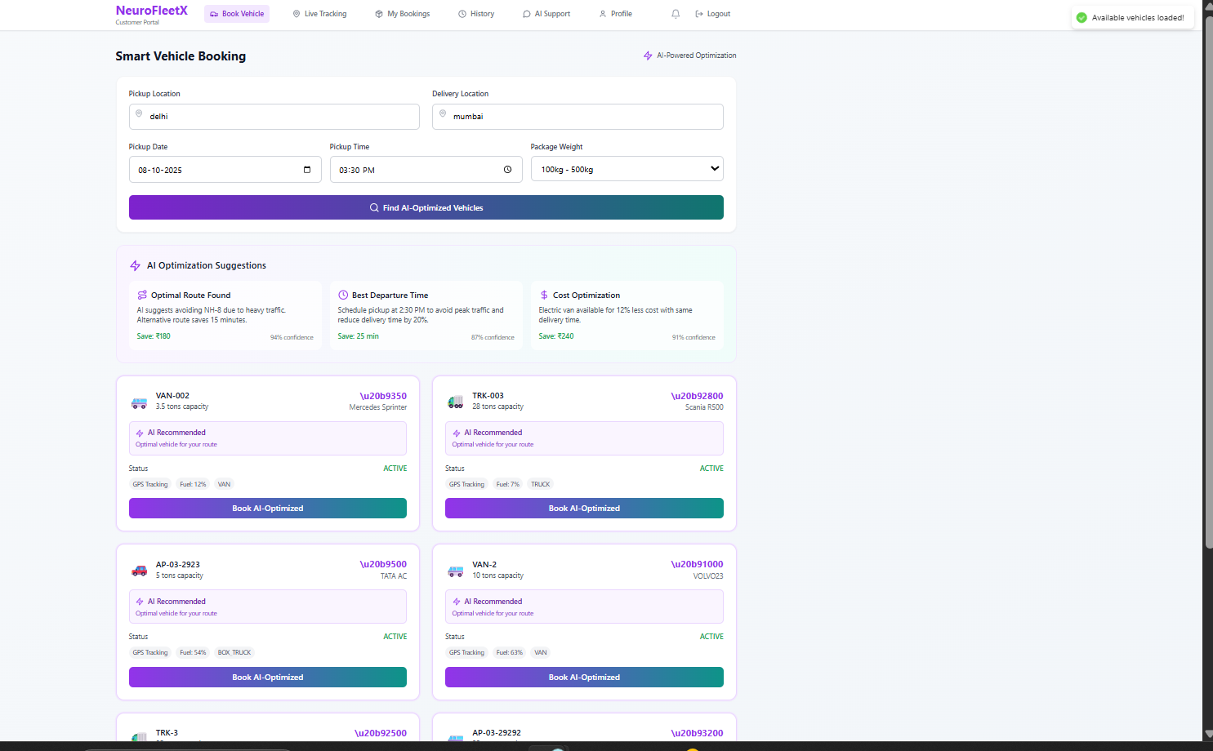
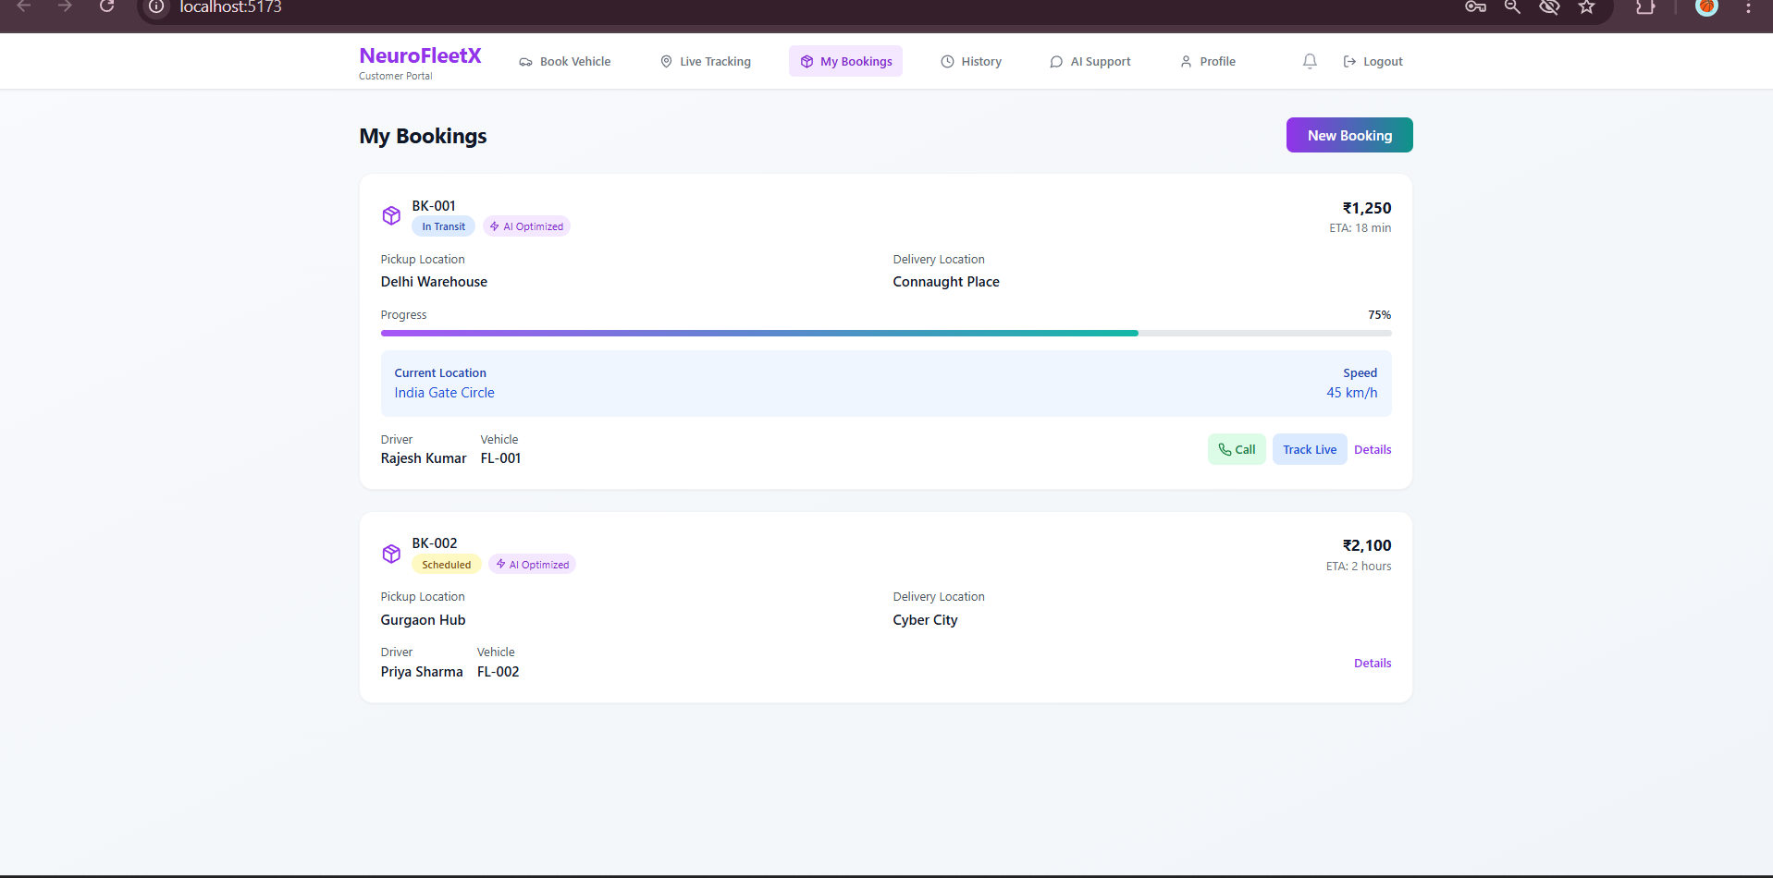
Customer portal pages

Slide 19
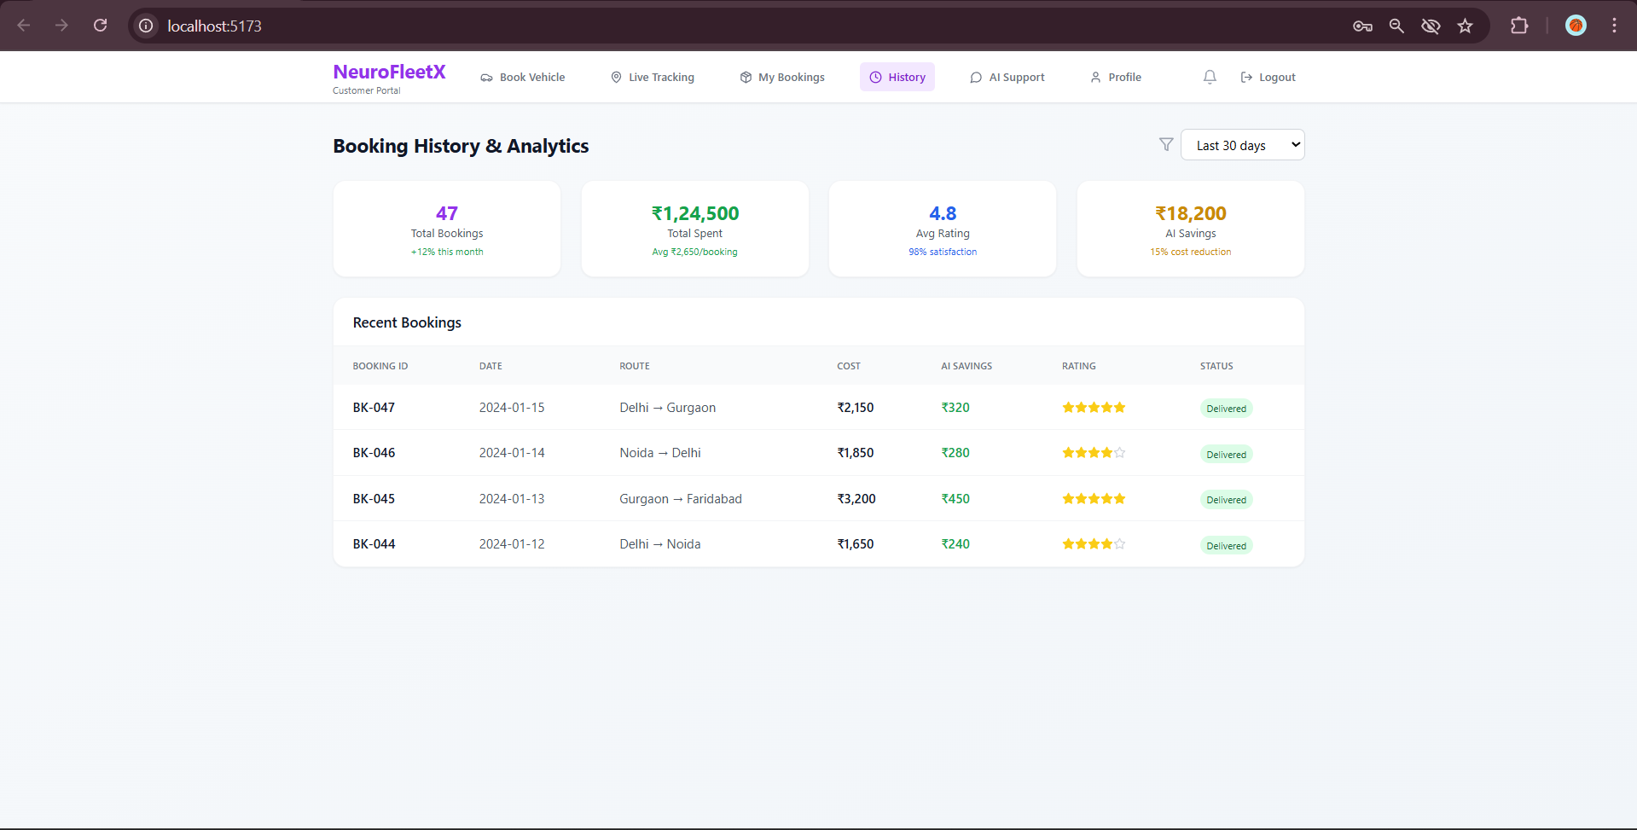
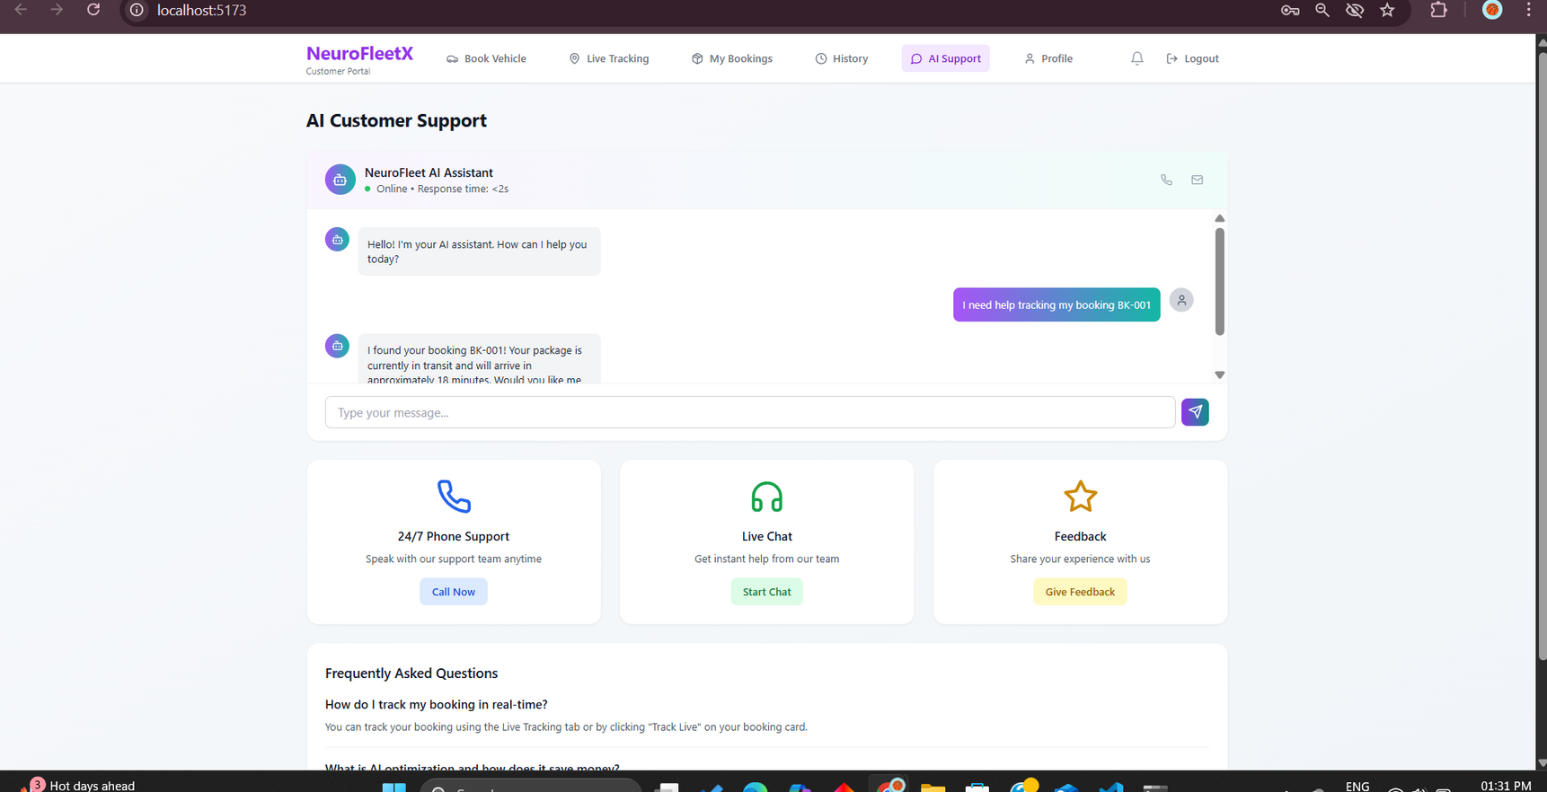
Customer portal pages

Slide 20

CONCLUSION
NeuroFleetX successfully demonstrates how AI and IoT can modernize urban transport.
The platform improves operational efficiency, customer satisfaction, and data-driven management.
Future Scope:
Integration with real GPS/IoT sensors
Deep learning for driver behavior analysis
Cross-city fleet management

Slide 21
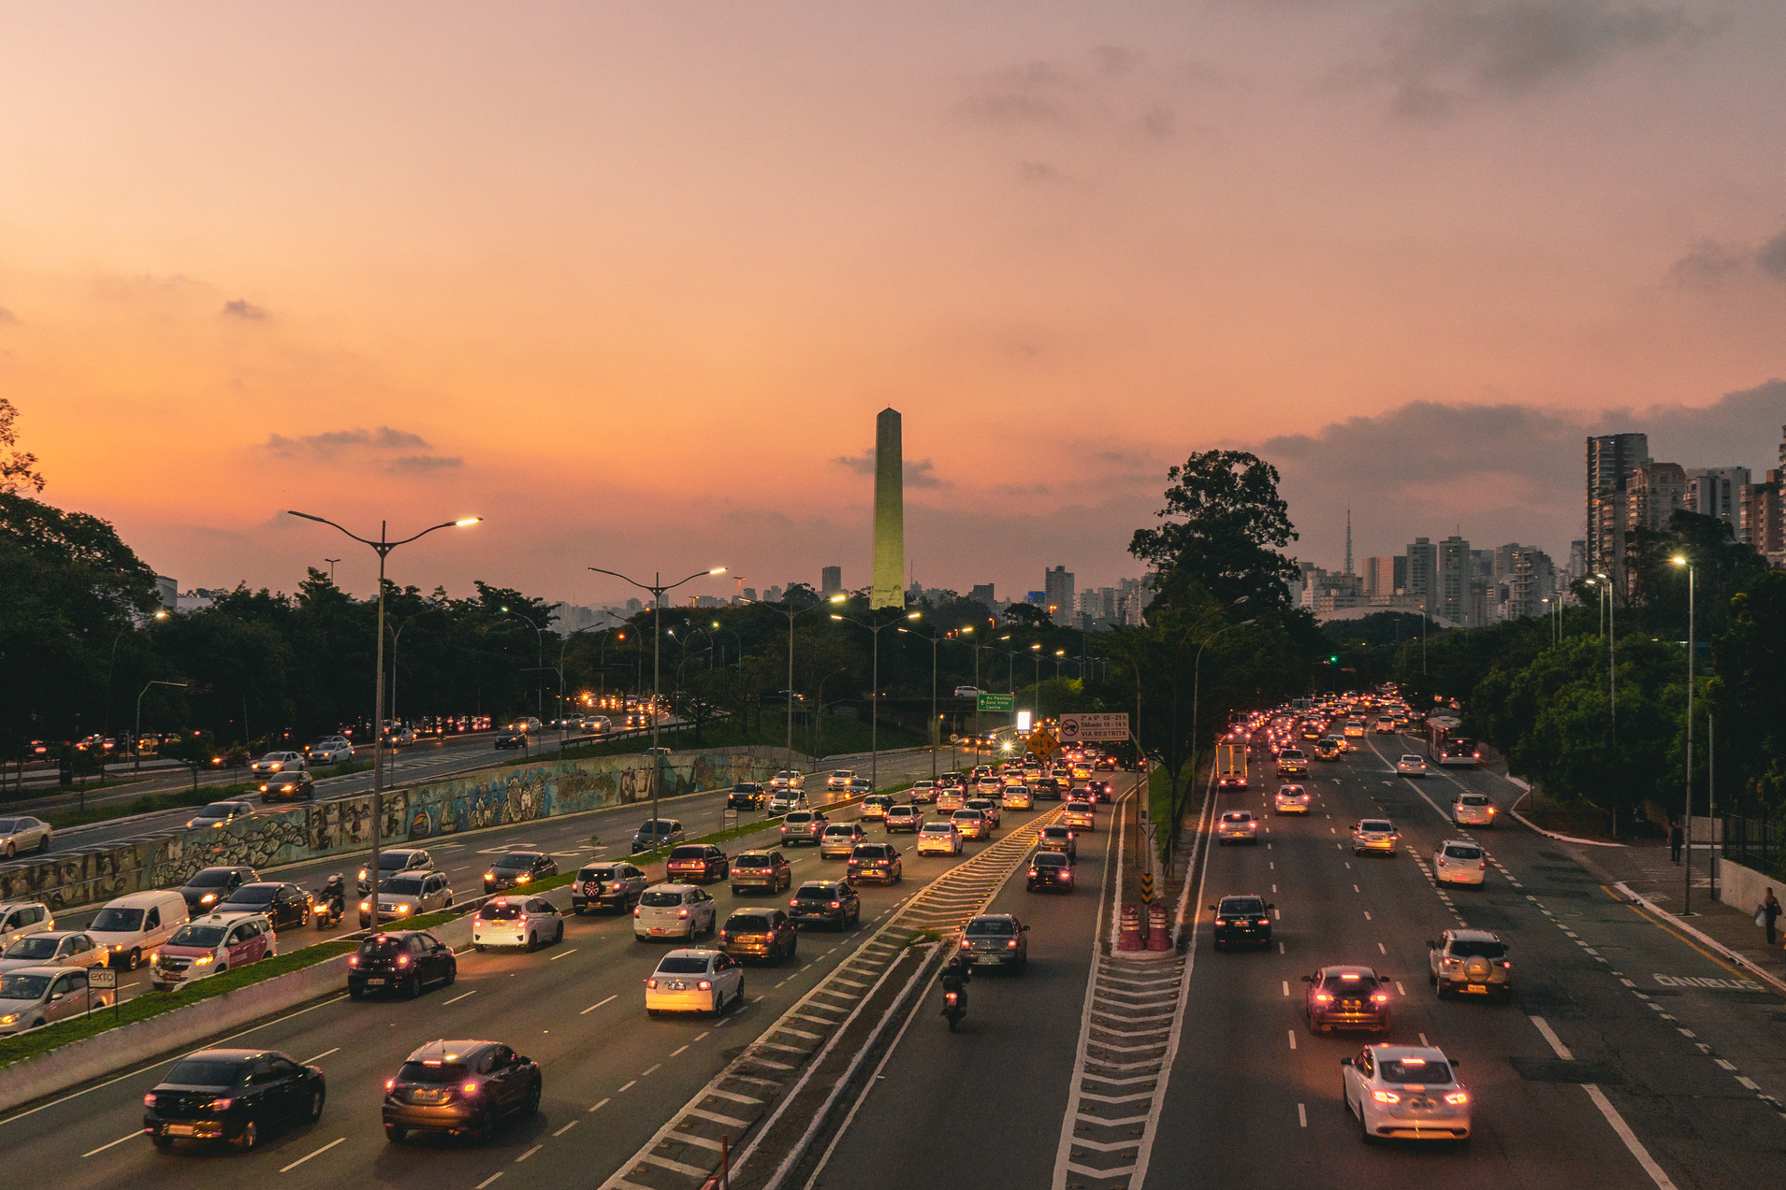
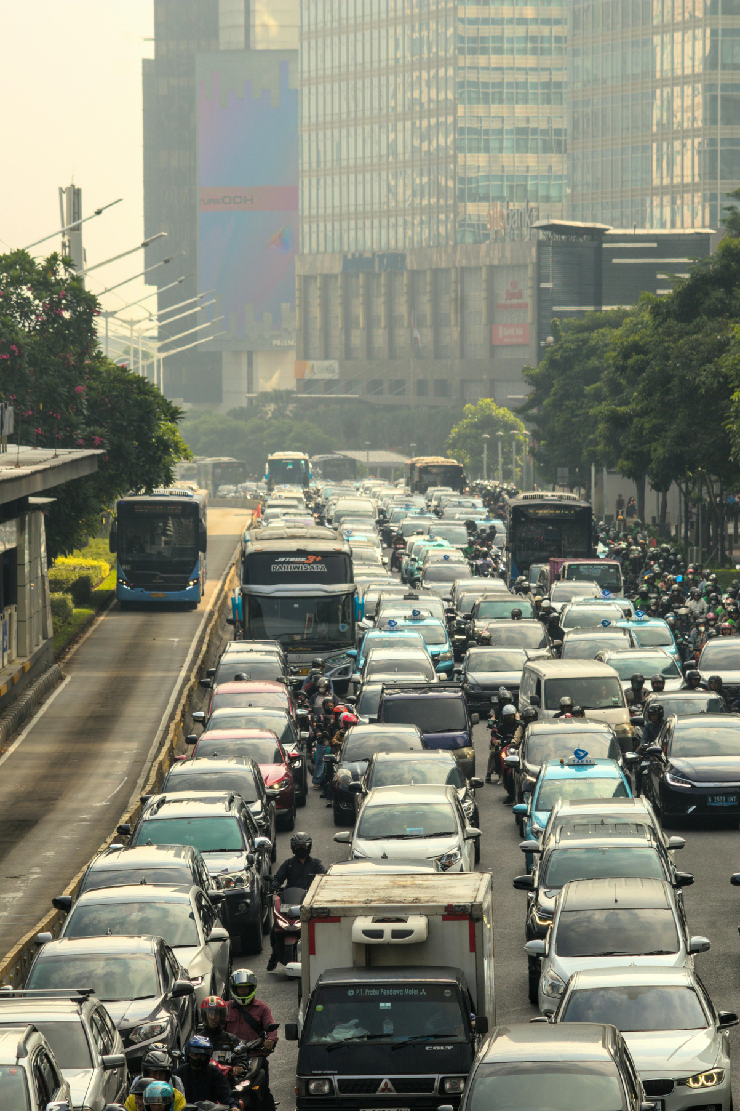

THANK YOU
CONNECT WITH US.
m.jayanth431@outlook.com

